Slide 1
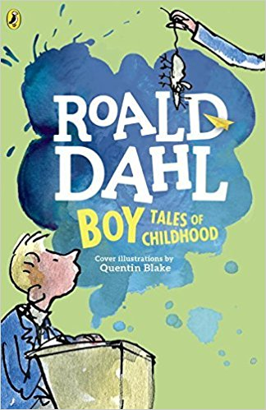
ROALD DAHL BOY AND THE GREAT MOUSE CONSPIRACY
Ins. Francesca Busi
Rassina
Anno Scolastico 2016 - 2017

Slide 2
Che cosa è il clil e perché si usa
CLIL, Content and Language Integrated Learning, indica la metodologia didattica che consiste nell’insegnamento in lingua straniera delle discipline ed è centrata sugli apprendimenti. Essa prevede che i percorsi didattici siano inclusivi e attivi.
Il CLIL mira a sviluppare:
abilità comunicative,
abilità relazionali,
abilità cognitive generali e specifiche.

Slide 3
DISCIPLINE COINVOLTA | DESTINATARI | TEMPI | SPAZI | MATERIALI E STRUMENTI UTILIZZATI
ITALIANO INTRECCI INTERDISCIPLINARI: STORIA ARTE | GLI ALUNNI DELLA CLASSE V DELLA SCUOLA PRIMARIA DI RASSINA | 5 LEZIONI DI UN’ORA E MEZZO CIASCUNA | AULA DI CLASSE E LABORATORIO TEATRALE | QUADERNI, PASTELLI, COLLA, FORBICI, NASTRO ADESIVO, FOGLI FORMATO A3, ABITI E MATERIALI DI SCENA, LIM, TELECAMERA.
La disciplina scelta non è certamente fra le più utilizzate di solito per lavorare in modalità CLIL. Ho voluto lanciare alla mia classe questa sfida didattica, che devo dire è stata accolta con grinta e partecipazione. Trattandosi di un argomento piuttosto complesso (mi sono infatti agganciata al progetto annuale di lettura proposto dall’insegnante di italiano), ho preferito lavorare tramite discussioni di gruppo e giochi.

Slide 4
CLIL TOPIC PLANNING
ROALD DAHL BOY AND THE GREAT MOUSE CONSPIRACY –A PROJECT FOR THE V A OF THE PRIMARY SCHOOL OF RASSINA
CONTENT | COGNITION | CULTURE | COMMUNICATION
I will teach: - what it means to do an analysis of the text in English; - reflection on the characters, in particular the making of some characters in the book "Roald Dahl Boy"; - reflection on how it was structured the English school in the ‘900, again by examining the context of the book; - draw, using the imagination, a child attending school in the early ‘900 and tell the product of their work to others; - the interpretation of a particularly funny scene in the book, "The great mouse conspiracy", through role play; - manage a group game, treasure hunt, which encloses all the work on the book. Linguistic objectives: - keywords for analysis of the book, the main character, secondary character, protagonist, antagonist, start, conduct and end. Learning new words (in particular adjectives) of the literary language as direct, indirect speech, narrative text, descriptive text. - Keywords for studying the school of the early '900: college, dorm, uniform, rules, principal. - Oral introduction of past simple verbs. | Reflect on the environment in which it takes place a story. - Knowing how to report orally on the characters and the situation they live in. - Knowing how to organize chronologically, logically and narratively, the information regarding a story. - Read and interpret a story. - Recognize the characters, their roles and their characteristics. - Draw the story proposal. - Knowing how to draw a picture and then describe to the others. - Knowing how to complete a crossword puzzle on the information learned from the book. - Knowing how to complete the phrases concerning the proposed text. | - Reflect on the English school of the early '900. - Understand that we are located in another era. - Understand that we are located in another culture. - Understanding the uses and customs of this culture. - Compare it with ours; we investigate how the school of the early’900 in Italy was. | - Discussing in groups peer. - Understand a text and represent it. - Acting the part of a story. - Produce and describe an image inserted in a well predetermined context. - Use a language that is accessible to the class, consider special needs. - Improve their language skills.

Slide 5
IL PROGETTO
Il progetto si è snodato in cinque fasi corrispondenti ognuna a una lezione di un’ora e mezzo. Si è lavorato utilizzando principalmente la lingua inglese come canale comunicativo.
Terminato tutto il lavoro gli alunni si sono auto-valutati, riflettendo su cosa hanno saputo fare e cosa ancora devono migliorare.
Hanno poi valutato le singole attività proposte, dando un loro personale parere su quanto le hanno giudicate stimolanti.

Slide 6
First Clil lesson: riddles
The first phase of CLIL was: the riddles.
The teacher has built a small vocabulary of specific words in literature by playing with the pupils.
She wrote to the black board pieces of words that children have completed saying the missing letters of the alphabet.

Slide 7
First Clil lesson: riddles

Slide 8
Second clil lesson: mimi
The second phase of CLIL was: mimi.
The teacher wanted to enter more specifically in the book "Roald Dahl Boy".
Children, in Italian, already know the characters. So she mimed the characters one by one (especially the characters of the chapter “The great mouse conspiracy”) and the children, with the help of her, described them by extolling the main adjectives that concern them. So they built an ID card of them on the notebook.
.

Slide 9
SECOND CLIL LESSON: mimi

Slide 10
Third clil lesson: between history and drawings
The third phase of CLIL was: between history and drawings.
The teacher wanted to compare the school reality of Rolad Dahl's age with today's school reality, because the chapter “The great mouse conspiracy” is principally placed at school.
She described to students how the children were dressing up to go to school at that time. The pupils have reproduced what the teacher described and showed and explained to the class their works.

Slide 11
Third clil lesson: between history and drawings

Slide 12
FOURTH CLIL LESSON: ACTION
The fourth phase of CLIL was: action.
The teacher and the students have specifically analyzed the chapter: "The great mouse conspiracy”.
The children have done a real recitation on this chapter, with script and dresses.

Slide 13
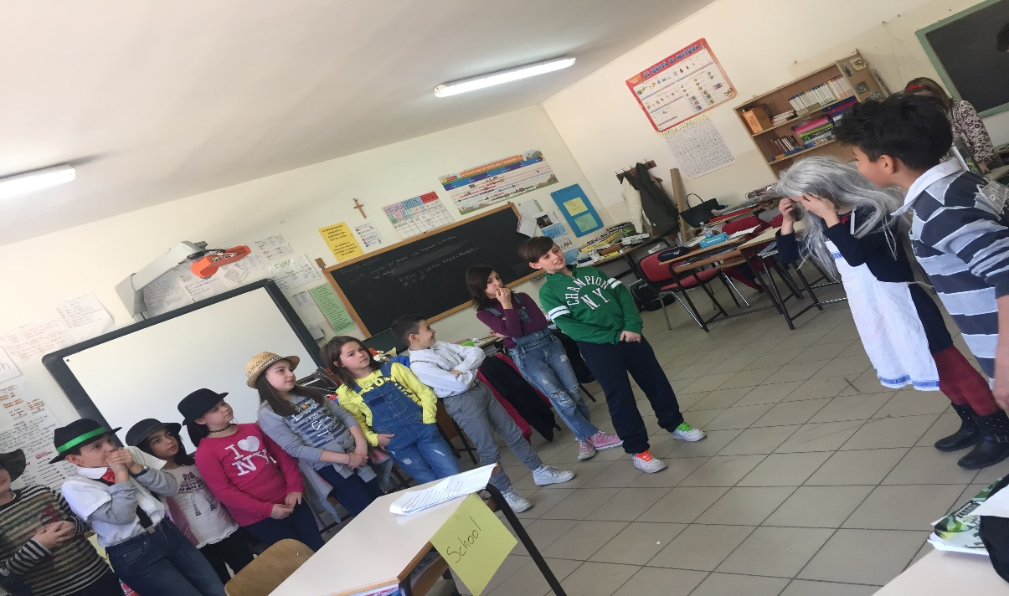
FOURTH clil lesson: action

Slide 14
fifth CLIL LESSON: TREASURE HUNT
The fifth and final phase of CLIL was: treasure hunt.
At the end of the job, the teacher designed a treasure hunt, dividing the class into three groups.
Treasure Hunt consisted of games containing all the topics discussed during the phases of the work.

Slide 15
FIFth CLIL LESSON: treasure hunt

Slide 16
VALUTAZIONE
Come precedentemente detto, il CLIL mira a sviluppare:
abilità comunicative,
abilità relazionali,
abilità cognitive generali e specifiche.
La valutazione consiste, pertanto, in un’osservazione costante degli alunni che progressivamente ampliano il proprio bagaglio conoscitivo e lo applicano in funzione dello sviluppo di queste abilità.

Slide 17
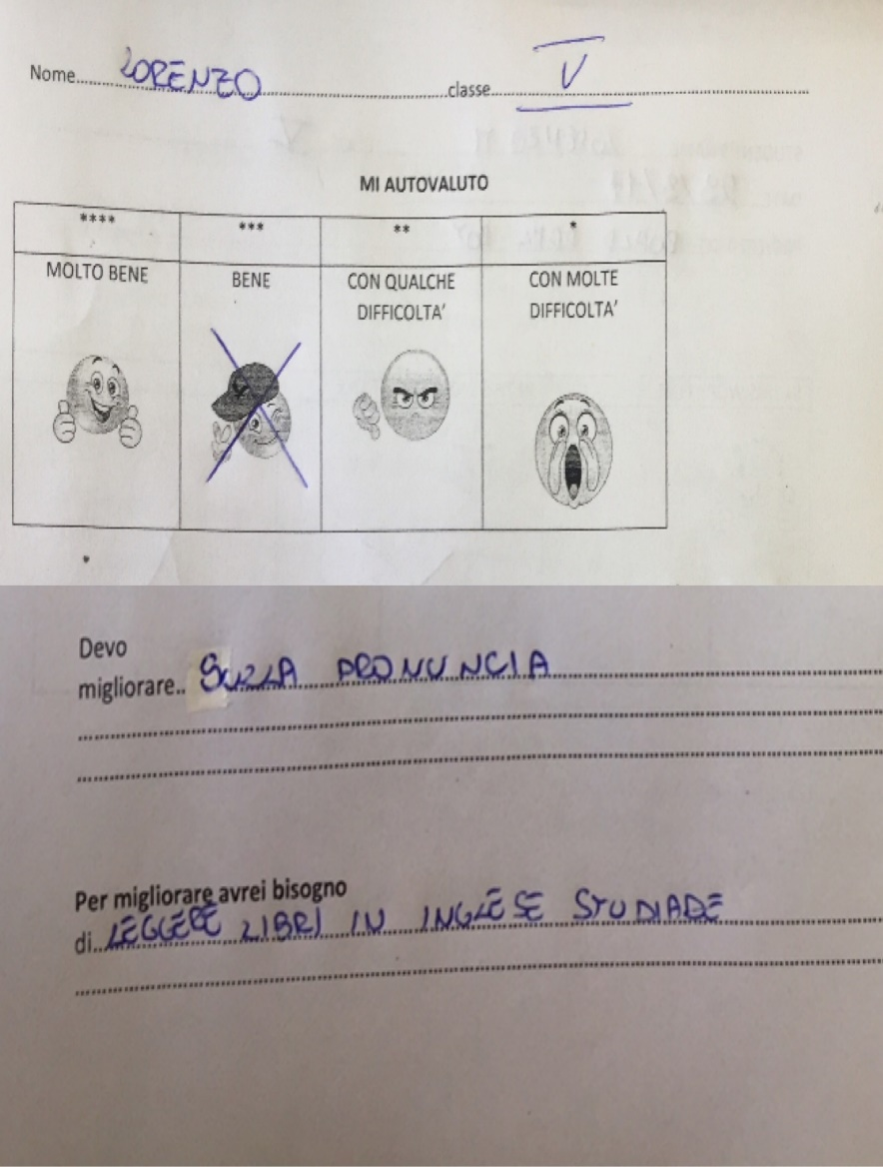
AUTOVALUTAZIONE DEGLI ALUNNI

Slide 18
INDICE DI GRADIMENTO DELLE Attività: QUANTO VI è PIACIUTO QUESTO LAVORO?

